Slide 1
HAPPY THANKSGIVING TO YOU!

Slide 2
Why did the Pilgrims leave England?
A) They were Puritans and were persecuted by the Church of England.
B) They were Separatists and were persecuted by the Church of England.
C) It was too cold for them.
D) They were pagans and were persecuted by the entire country of England.

Slide 3
How many ships did the Pilgrims have originally?
A) One. Mayflower.
B) Two, the Speedwell and the Mayflower.
C) One, of course. May’s Flower.
D) Two: Godspeed and Mayflower.

Slide 4
Where did the Pilgrims originally want to settle?
A) Jamestown
B) Plymouth
C) Cape Cod
D) The Hudson River

Slide 5
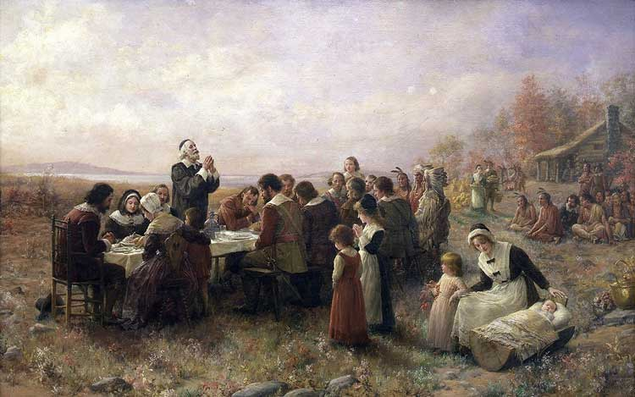
In 1676, a day of thanksgiving was proclaimed to take place during what month?
A) December
B) June
C) November
D) October

Slide 6
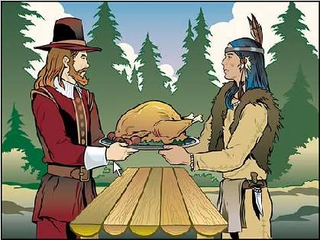
Who was the Pilgrim leader that invited neighboring Indians to the Thanksgiving Feast?
A) Miles Standish
B)John Bunny
C)William Bradford
D) William Penn

Slide 7
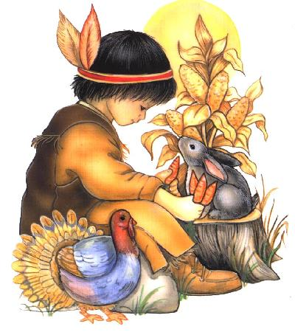
What was the name of the Indian chief who was invited to the first Thanksgiving by the settlers?
A) Squanto
B) Pocahontas
C) Chingachgook
D) Massasoit

Slide 8
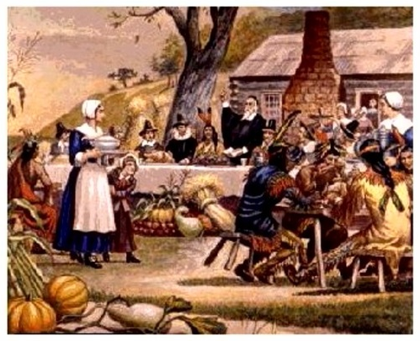
What food was probably NOT on the Pilgrims’ Thanksgiving menu?
A) Corn
B) Potatoes
C) Fish
D) Meat

Slide 9
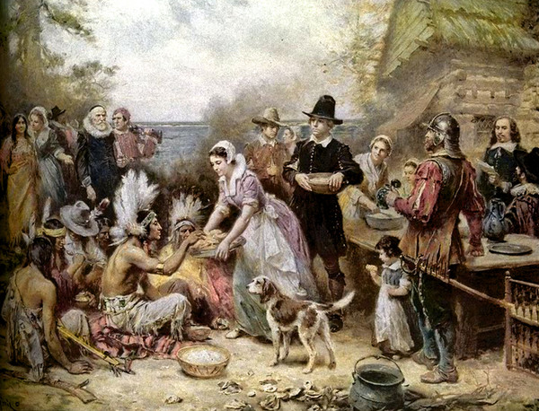
How long did the first Thanksgiving celebration last?
A) 5 days
B) 3 days
C) 7 days
D) 2 days

Slide 10
Which country first adopted Thanksgiving as a national Holiday?
A)Mexico
B)England
C)Canada
D)United States

Slide 11
Which president first established the date of Thanksgiving as a national celebration?
A) Lincoln
B) Washington
C) Jefferson
D) Adams

Slide 12
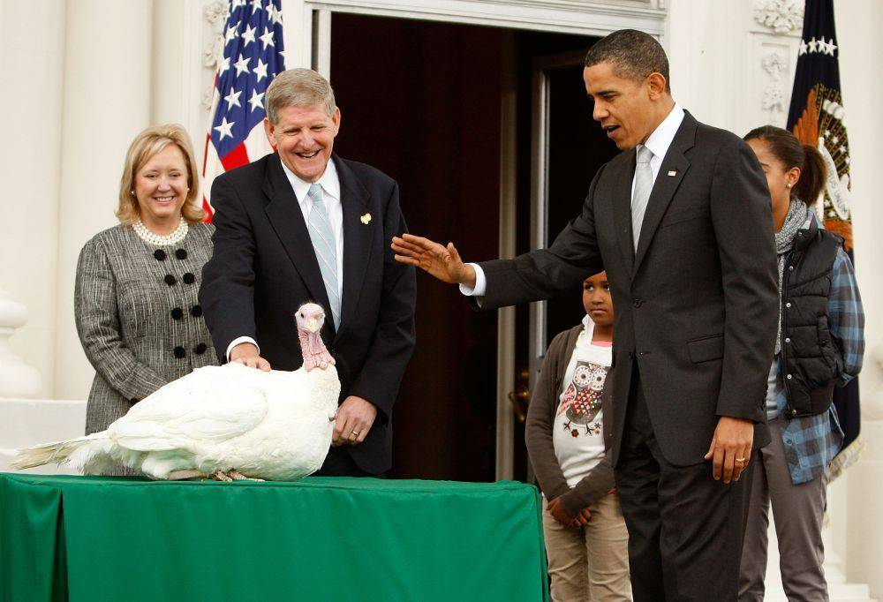
What president didn’t like the idea of having a national Thanksgiving Day?
A) Jefferson
B) Bush
C) Obama
D) Washington

Slide 13
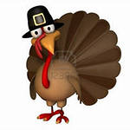
What are male turkeys called?
A) Sparkey
B)Toms
C) Leghorns
D) Roosters

Slide 14
What sound does a male turkey make?
A) chirp
B) peep
C) gobble
D) cluck

Slide 15
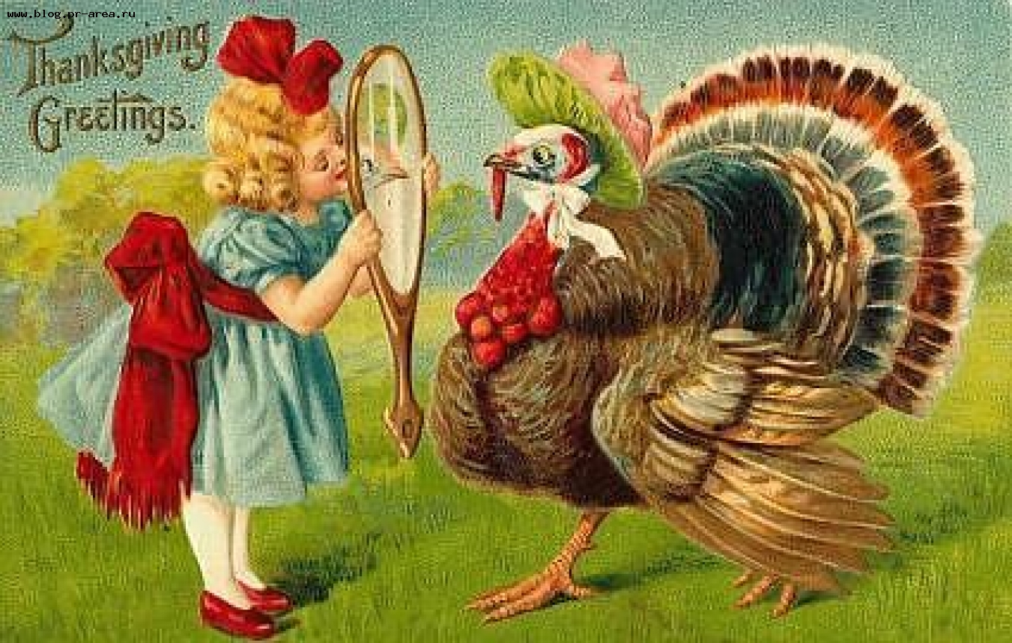
What are female turkeys called?
A) Hens
B) Fillies
C) Chicks
D) Flams

Slide 16
What sound does a female turkey make?
A) cluck
B) chirp
C) gobble
D) peep

Slide 17
What are baby turkeys called?
A) Turklets
B) Poults
C) Chicks
D) Kidlings

Slide 18
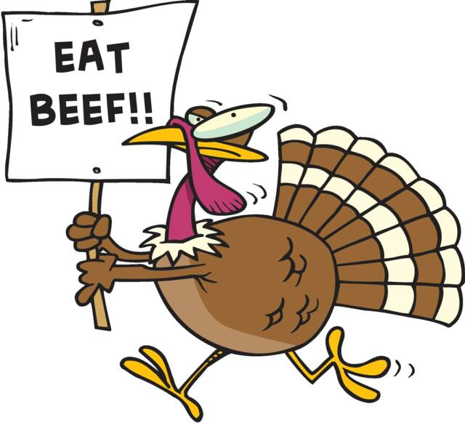
How fast can wild turkeys run?
A) 25 mph
B)15 mph
C) 5 mph
D) 45 mph

Slide 19
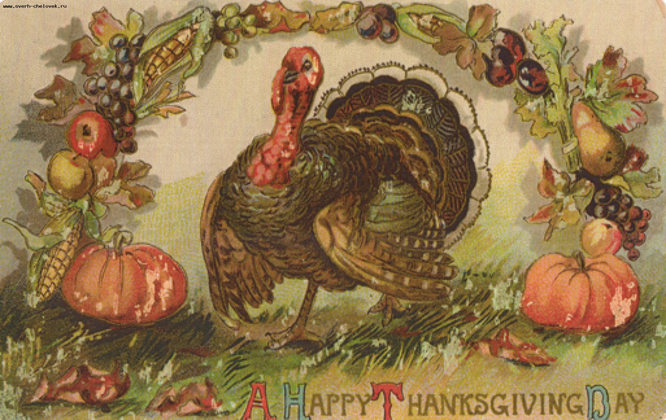
Can wild turkeys fly? If so, how fast?
A) Yes, up to 40 mph.
B) No.
C) Yes, up to 25 mph.
D) Yes, up to 55 mph.

Slide 20
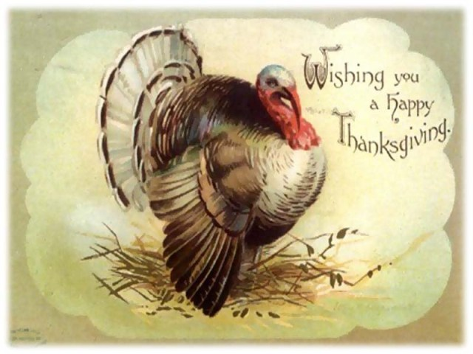
About how many feathers does a mature turkey have?
A) 5,000
B) 2,000
C) 1,500
D) 3,500

