Slide 1
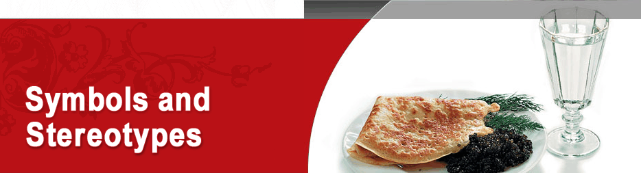

Slide 2

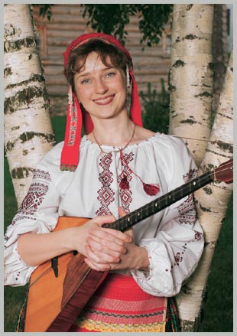
Foreigners have many stereotypes about Russian life. Alexander Dumas the Elder, a French novelist who managed to travel through Russia, may have paved the way for some of them. The author of Les Trois Mousquetaires (“The Three Musketeers”) described in one of his novels how he rested “under a patulous cranberry.” Actually, a cranberry is a very small bush that flourishes in Russia’s marshlands so it’s hard to imagine the author fitting under one and even harder to imagine him resting in a swamp! Since that time, the phrase “patulous cranberry” has become a Russian idiomatic expression meaning an incompetent or perfunctory judgement.
The stereotypical understanding is that Russia is a faraway, snowy country, where one must wear a furcoat and valenki (felt boots), people do nothing but drink vodka and play balalaikas, while bears are leaving their forest homes to go walking down village streets. However, the reality of our life is very far from this idyllic myth: balalaikas, bears, and felt boots have more or less become symbols of Russia rather than attributes of everyday life.

Slide 3
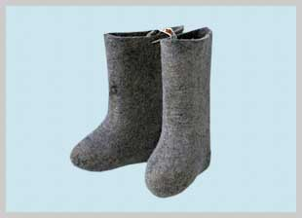
VALENKI
Valenki, or felt boots, are Russian national footwear. They are traditionally made of milled fleece, and each pair requires at least a kilogram of fleece that must undergo a long processing treatment. It must be combed out, made into thin strips of felt, shaped, boiled, and dried out. In the old times, the centre for valenki production was Ouglich, a small city in the Upper Volga area; currently, this footwear is made all over Russia. In the 18th century, felt boots were an expensive, luxury gift: Peter the First and Catherine the Great ordered specially made valenki for their personal wardrobes. Soviet leaders such as Lenin, Stalin, Khrushchyov, and Marshall Zhukov also appreciated valenki. Today, valenki are still irreplaceable as footwear in the countryside and in the army: felt can resist –40 °C (–40 °F) freeze and protect the soldiers’ feet in combat.

Slide 4
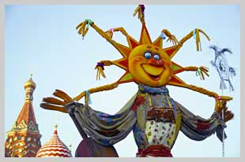
MASLENITSA (SHROVETIDE)
This is one of the most rambunctious and joyful folk holidays in Russia. It symbolizes the end of winter and takes place at the end of February or beginning of March. During Soviet times, Maslenitsa was a quiet family holiday. However, now it is again celebrated by the entire country — people have fun outside, sing songs, go sledding, and ride on Russian troikas. The main special treats associated with Maslenitsa are bliny (crêpes). They are round, ruddy, and hot like the sun, to which this pagan Slavic holiday is dedicated.

Slide 5
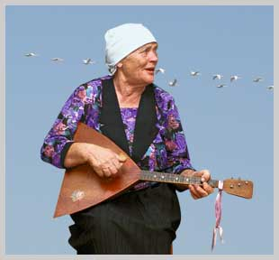
BALALAIKA
The balalaika is a plucking string instrument that resembles a guitar, but has a triangular shape and only three strings (or two in some cases). Nowadays, the balalaika has disappeared from people’s everyday life almost completely. Only professional musicians in Russian folk music ensembles and folk instrument orchestras play the balalaika.

Slide 6
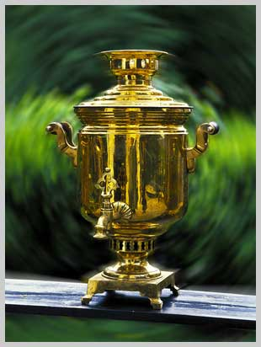
SAMOVAR
The Russian word samovar literally means “self-boiling.” The vessel consists of a metal container for boiling the water and a fire-pan with a tube. Samovars appeared in Russia in the second quarter of the 18th century and, in the course of one hundred years, became an integral part of every Russian household, restaurant, or hotel. The samovar had both a practical and an emotional function: it became a unifying symbol for people when they gathered to have tea parties and provided the right atmosphere for friendly conversation. Though samovars first appeared in the Urals, the production of samovars blossomed in Tula, an old city to the south of Moscow, also famous for its armories and spice-cakes.

Slide 7
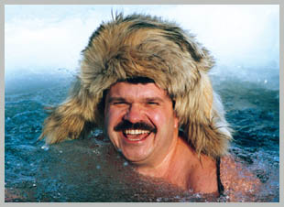
FUR HATS
A winter hat with ear-flaps and warm covering for the back of the head can protect one against the severe Russian cold. In the past, only peasants would wear such hats — they called them the “three-eared hats.” In 1940, the Red Army substituted winter helmets with earflap hats, and since then the hats have become popular among civilians, men as well as women. Most foreigners buy black and gray military hats with faux fur, but the Russians prefer ear-flap hats of expensive natural fur: mink, nutria, muskrat, or fox. During the Soviet times, such hats were difficult to find, and state officials would wear fur trim of quality depending on their rank.

Slide 8
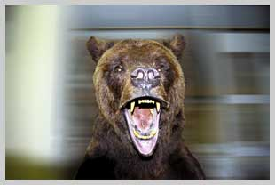
RUSSIAN BEAR
One of Russias' favorite animals is the bear, a hero of many legends and fairytales. Russians tenderly give bears the human name of Misha (sometimes adding a patronymic name out of respect — hence, Mikhail Potapych). They also apply bear-like qualities to people; a clumsy but kind person is referred to as a “bear.” The little bear cub was chosen to be Russia’s mascot in the 22nd Olympic Games held in Moscow in 1980. Bears live throughout Russia, and there are two main kinds: brown bears that are forest dwellers (the bear in those areas is also nicknamed the “chief of the taiga”), and white bears that dwell in polar areas. The popular foreign stereotypes notwithstanding, you will not see bears roaming the streets of towns and cities, but you can still see them in a zoo or a circus.

Slide 9
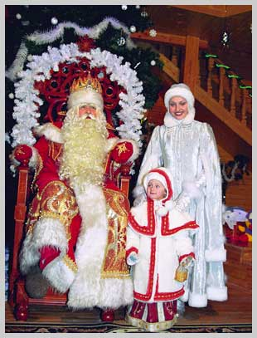
GRANDFATHER FROST AND THE SNOW MAIDEN
Ded Moroz (Grandfather Frost) is a fairytale character who brings New Year’s and Christmas gifts to children every year. He is a big and stately older man with a deep voice, dressed in felt boots, a fur cap, and a coat that reaches to his heels. He either puts the gifts under the tree or hands them out to children himself: in this way, he is different from Santa Claus who leaves the gifts in Christmas stockings. The Russian Grandfather Frost has a granddaughter, Snegurochka (the Snow Maiden), who comes with him to wish children a happy New Year. The homeland of Grandfather Frost is Veliky Oustyug, an old town in the Vologda Region.

Slide 10
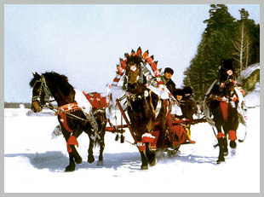
TROIKA
The troika is a Russian traditional triple harness, which connects the horses to sleighs, carts, or covered wagons. This troika ride has been recognized as the most spirited, fun, and fastest way to travel, and the sensations that it evokes are in tune with the Russian personality and spirit. Nikolai Gogol coined the famous phrase: “What kind of Russian man doesn’t like a spin?” The troika has become one of the most famous symbols of Russia, not to mention a favourite winter entertainment for tourists.

Slide 11
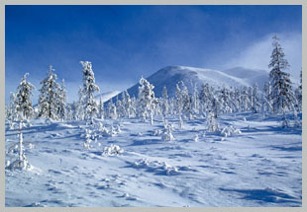
FROST
Russia is the coldest country in the world, where winter lasts for four to five months throughout the larger part of its territory, about seven months in Central Siberia, and ten months in the transpolar areas. It is in Russia, in the Republic of Sakha (Yakutia), where the northern hemisphere’s coldest point is located: the mercury can go down to –72 °C (–97.6 °F) there. Severe frost can also be felt in Moscow, where a record low temperature of –42 °C (–43.6 °F) was recorded in the winter of 1942. The Russians are used to frosty weather, enjoying winter sports and festivities such as skiing, skating, and sledding. However, the severe climate does create many problems in everyday life. Buildings must be built with very thick walls to insulate them for effective heating and protection from the cold, roads must be clear from ice and snow. All of this requires money and effort, not to mention the extra warm clothing and footwear that one needs to survive the winter months.

Slide 12
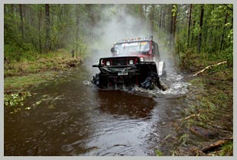
ROADS
Life in Russia depended on roads since the old days. Many fairy tales are based on journeys; legends tell of hermits, pilgrims, and wanderers whom one can meet along the way. At the same time, Russians themselves often criticize their roads. As early as the 19th century, Nikolai Gogol, the famous writer, noted that “Russia’s two biggest problems are fools and roads.” Russians still use the word “road” for any type of terrain that they drive through, paved or not. Our immense country has many places where there are no people, much less roads. However, the developed areas have undergone many changes in recent years: roads are either built or are being built, though, given the enormous distances between places, building roads is no easy task. One can still wait for a letter to get from one place in Russia to another for many weeks; even express mail cannot work as fast as it does in other places.

Slide 13
http://www.justrussia.ru/page.php?66

